Slide 1
Back Propagation
Course Code: CSC 4254
Course Title: Computer Vision & Pattern Recognition
Dept. of Computer Science
Faculty of Science and Technology
Lecture No: | 6 | Week No: | 3 | Semester:
Lecturer:

Slide 2
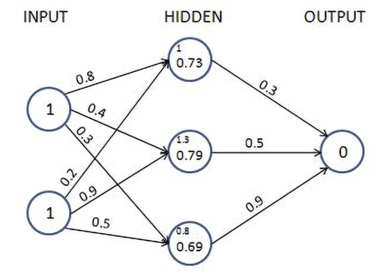

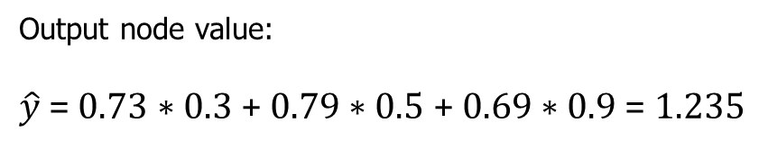

Feed Forward Output
Output node value:
$\hat{y}$= 0.73 ∗ 0.3 + 0.79 ∗ 0.5 + 0.69 ∗ 0.9 = 1.235
$$error=\left(y−\hat{y}\right)=−1.235$$

Slide 3

Back Propagation
In feedforward propagation, we connected the input layer to the hidden layer, which was then connected to the output layer. In the first iteration, we initialized weights randomly and then calculated the loss resulting from those weight values. In backpropagation, we take the reverse approach. We start with the loss value obtained in feedforward propagation and update the weights of the network in such a way that the loss value is minimized as much as possible.
The loss value is reduced as we perform the following steps:
Change each weight within the neural network by a small amount – one at a time.
Measure the change in loss $δL$ when the weight value is changed $δW$
Update the weight by $−k\frac{δL}{δW}$, where k is a positive value and is a hyperparameter known as the learning rate.

Slide 4
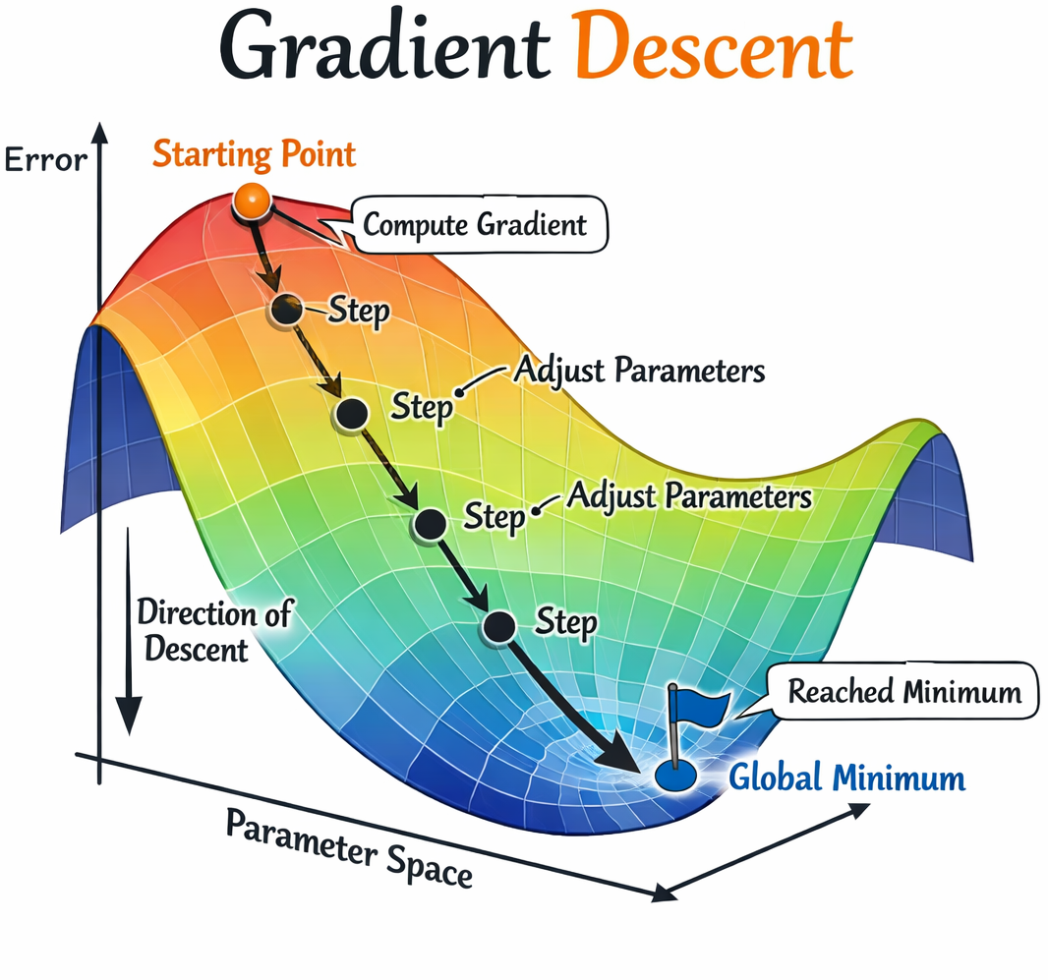
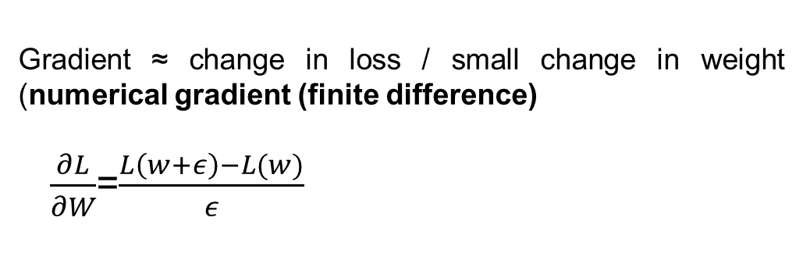

Gradient Descent
This whole process by which we update weights to reduce errors is called gradient descent. As mentioned, gradient stands for the difference (which is the difference in loss values when the weight value is updated by a small amount) and descent means to reduce. Alternatively, gradient stands for the slope (direction
of loss drop) and descent means to move toward lower loss.
Gradient ≈ change in loss / small change in weight (numerical gradient (finite difference)
$\frac{∂L}{∂W}$=$\frac{L\left(w+ε\right)−L(w)}{ε}$
$w$= weight
$ε$ = small changes in weight

Slide 5
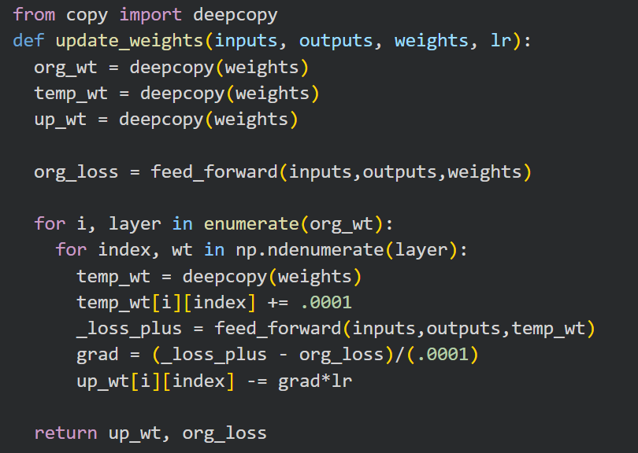
Update The Weights
Increase each weight and bias value by a very small amount (0.0001) and calculate the overall squared error loss value one at a time for each of the weight and bias updates.
Loss at First Iteration
Increment of small value
Loss due to change in weight
Numeric Gradient
Update the weight considering learning rate

Slide 6


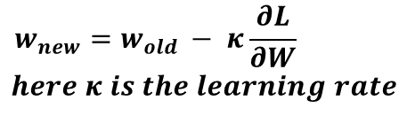

Problems in this approach
we have calculated gradients of loss concerning weight by updating the weight by a small amount and then calculating the difference between the feedforward loss in the original scenario (when the weight was unchanged) and the feedforward loss after updating weights.
One drawback of updating weight values in this manner is that when the network is large (with more weights to update), a large number of computations are needed to calculate loss values (and in fact, the computations are to be done twice
– once where weight values are unchanged, and
– again, where weight values are updated by a small amount).
$$\frac{∂L}{∂W}$$
$$w_{new}=w_{old }− κ\frac{∂L}{∂W}$$
$$here κ is the learning rate$$

Slide 7
Solution
Chain rule = when something depends on something else, and that depends on another thing, you multiply the rates of change. Example:
Your weight depends on how much food you eat
Food depends on how much money you have
Change in weight ← change in food ← change in money

Slide 8



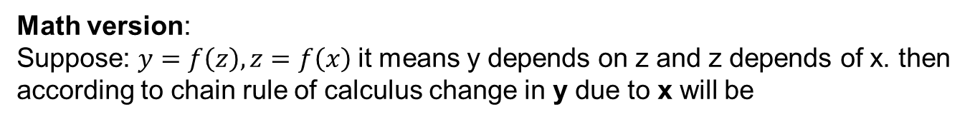



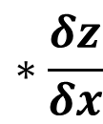
Chain Rule
Math version:
Suppose: $y=f\left(z\right), z=f\left(x\right)$it means y depends on z and z depends of x. then according to chain rule of calculus change in y due to x will be
$$\frac{δy}{δx}=$$
$$\frac{δy}{δz}$$
$$∗\frac{δz}{δx}$$
Let $z=x^{2}$ and $y=3z$
$$\frac{δy}{δx}=3∗2x=6x$$
$$\frac{δz}{δx}=2x$$
$$\frac{δy}{δz}=3$$

Slide 9
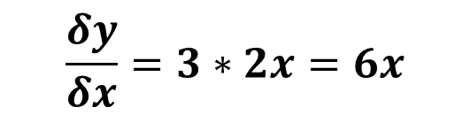


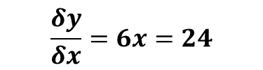
Chain Rule
Justification:
Let x = 4 so according to chain rule the change in y due to change in x should be
Let $z=x^{2}$ and $y=3z$
$$\frac{δy}{δx}=6x=24$$
$$\frac{δy}{δx}=3∗2x=6x$$
Now calculate manually Increase x by a small value
.01
$$x=4.01 so z=16.08 and y=48.24$$
Calculate the change
$$\frac{48.24−48}{.01}≈24$$

Slide 10
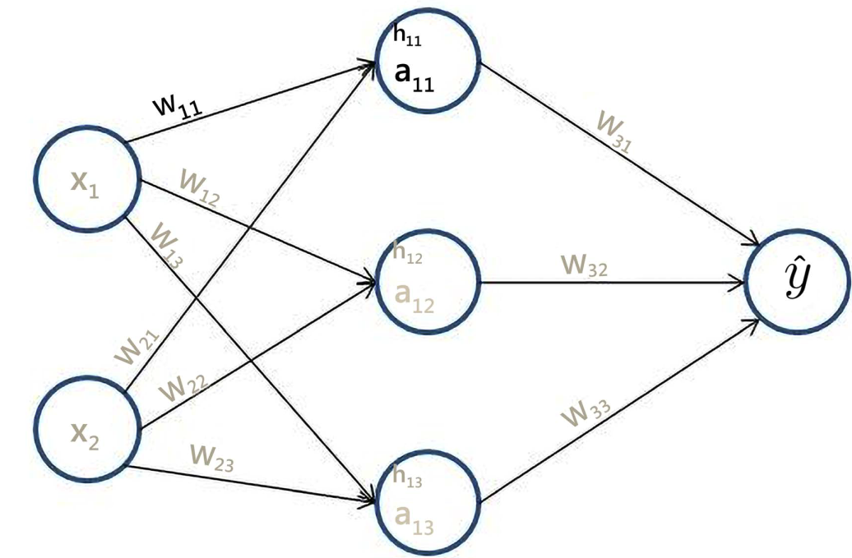


















Calculating change in Loss due to change of $w_{11}$(gradient)
Generalizing the values
$$Loss=$$
$${\left(y−\hat{y}\right)}^{2}$$
$$\hat{y}=$$
$$a_{11}∗w_{31 }+a_{12}∗w_{32 }+a_{13}∗w_{33 }$$
$$a_{11}=$$
$$\frac{1}{1+e^{−h_{11}}}$$
$$h_{11}=$$
$$x_{1}∗w_{11 }+x_{2}∗w_{21 }$$
$\frac{δLoss}{δw_{11}}$ =
$$\frac{δLoss}{δ\hat{y}}$$
$$∗\frac{δ\hat{y}}{δa_{11}}$$
$$∗\frac{δa_{11}}{δh_{11}}$$
$$∗\frac{δh_{11}}{δw_{11}}$$
$\frac{δ}{δ\hat{y}}$ ${\left(y−\hat{y}\right)}^{2}=$
$=−2∗\left(y −\hat{y}\right)∗$ $w_{31 }∗a_{11}∗\left(1−a_{11}\right)∗x_{11 }$
$−2∗(y$ $−\hat{y})$
$\frac{δ}{δa_{11}}$ $a_{11}∗w_{31 }$ $=$
$$w_{31 }(all the other terms are constant, greyed in equation of \hat{y})$$
$\frac{δa_{11}}{δh_{11}}$ $=a_{11}∗(1−a_{11})$
$\frac{δ}{δw_{11}}$ $x_{1}∗w_{11 }$ $=$
$$x_{11 }(all the other terms are constant, greyed in equation of{ h}_{11 })$$

Slide 11
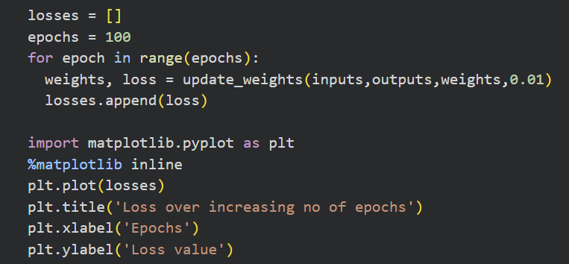
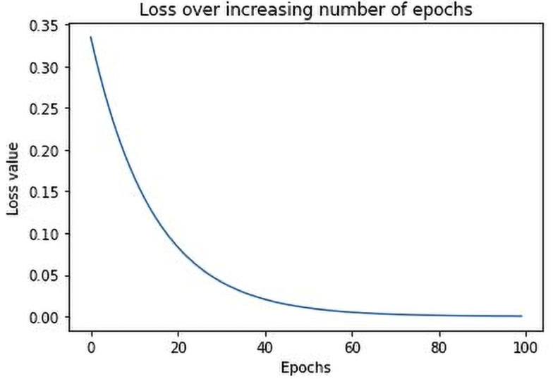

Analyzing Loss Values Over Epochs
Learning Rate
To Access Full Code, Click this button in slideshow

Slide 12
Impact of Learning Rate in Training
Let’s consider of a simple network
Input | Output | Weight
1 | 3
2 | 6
3 | 9
4 | 12
x
y

Slide 13
Impact of Learning Rate in Training
Let’s consider of a simple network
Input | Output | Weight
1 | 3 | 3
2 | 6 | 3
3 | 9 | 3
4 | 12 | 3
x
y

Slide 14
Demonstration in Code
To Access Full Code, Click this button in slideshow

Slide 15
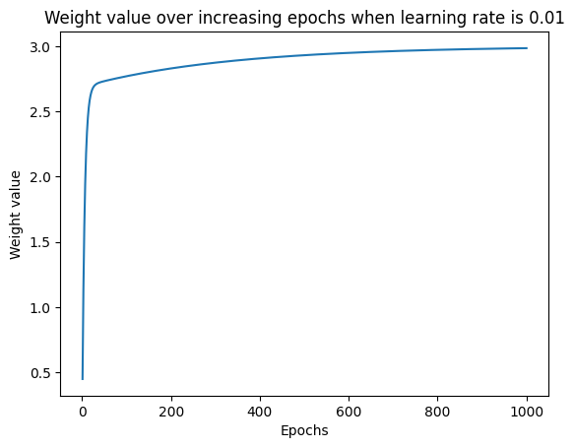
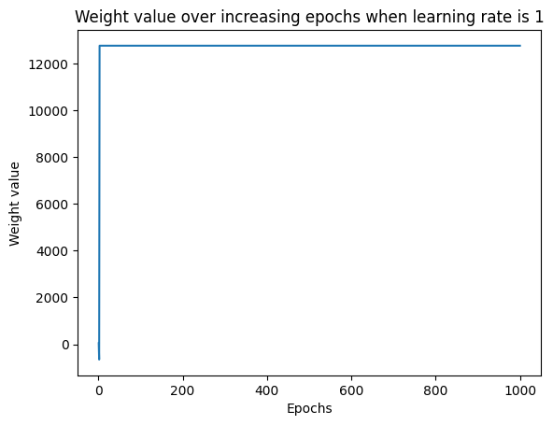
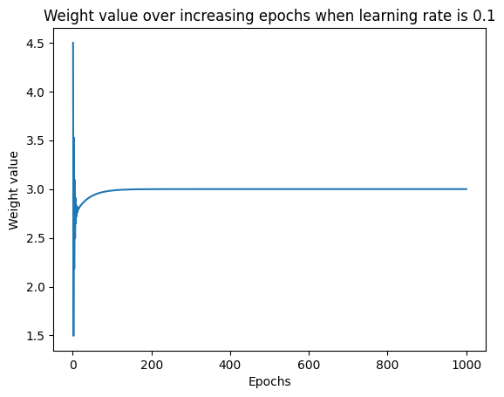
Findings on Different Kinds of Learning Rate
Learning Rate .01
Learning Rate 1
Learning Rate .1

Slide 16
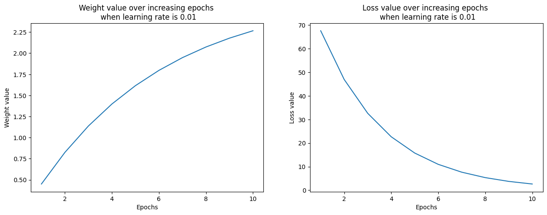
Change of Loss and Weight at LR .01

Slide 17
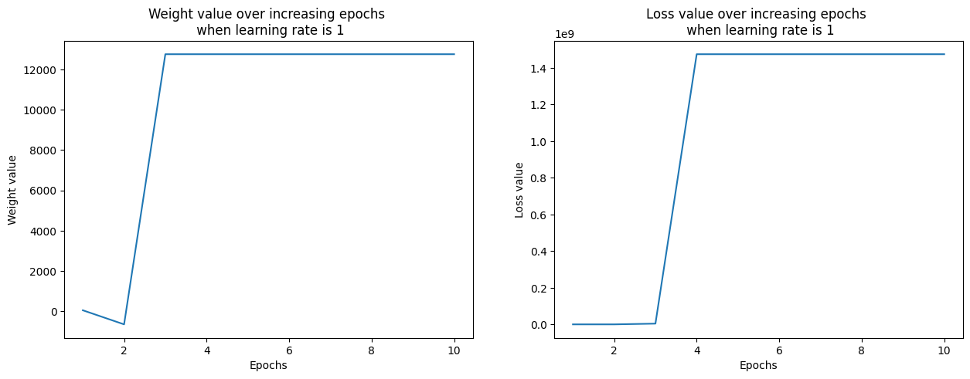
Change of Loss and Weight at LR 1

Slide 18
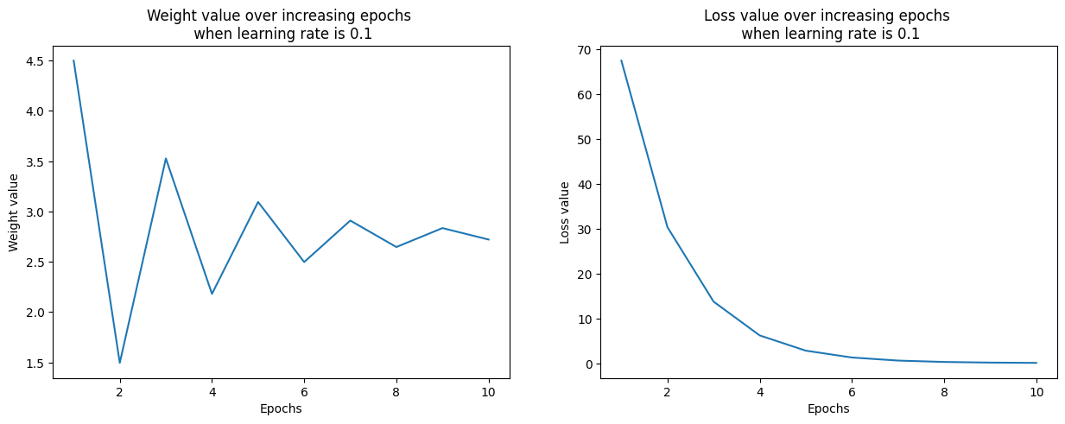
Change of Loss and Weight at LR .1

